Slide 1
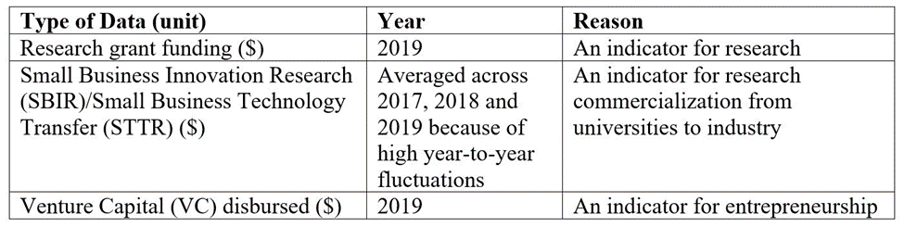
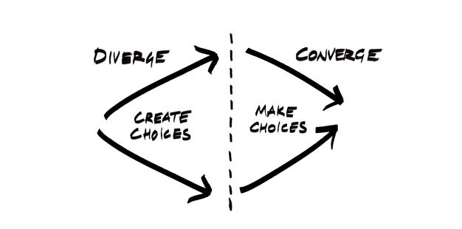
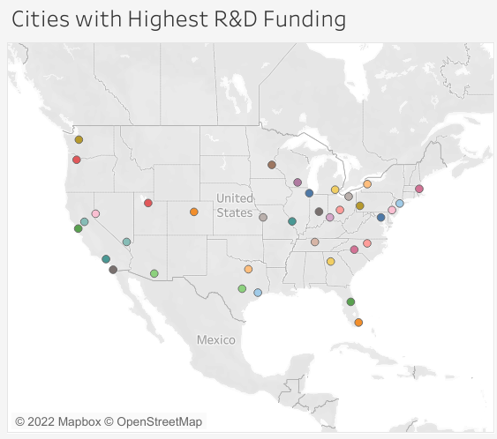
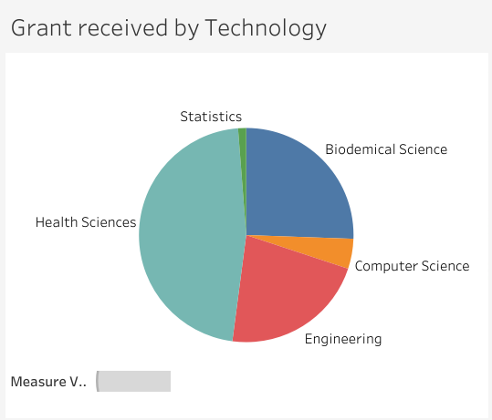
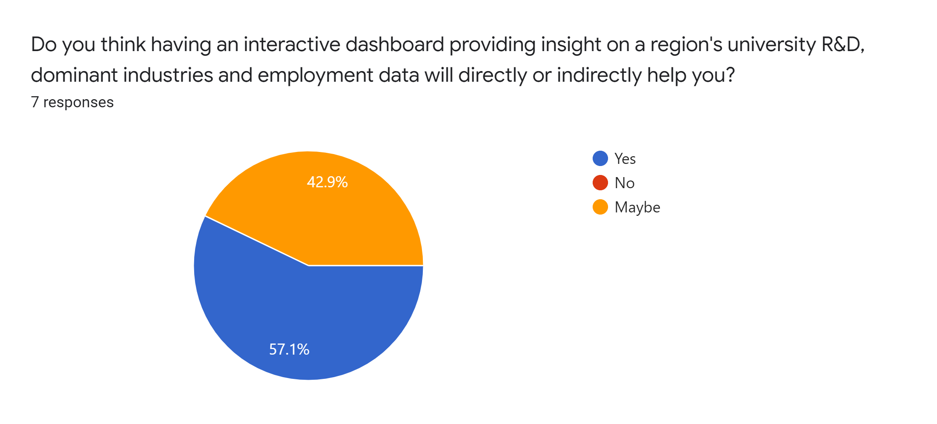
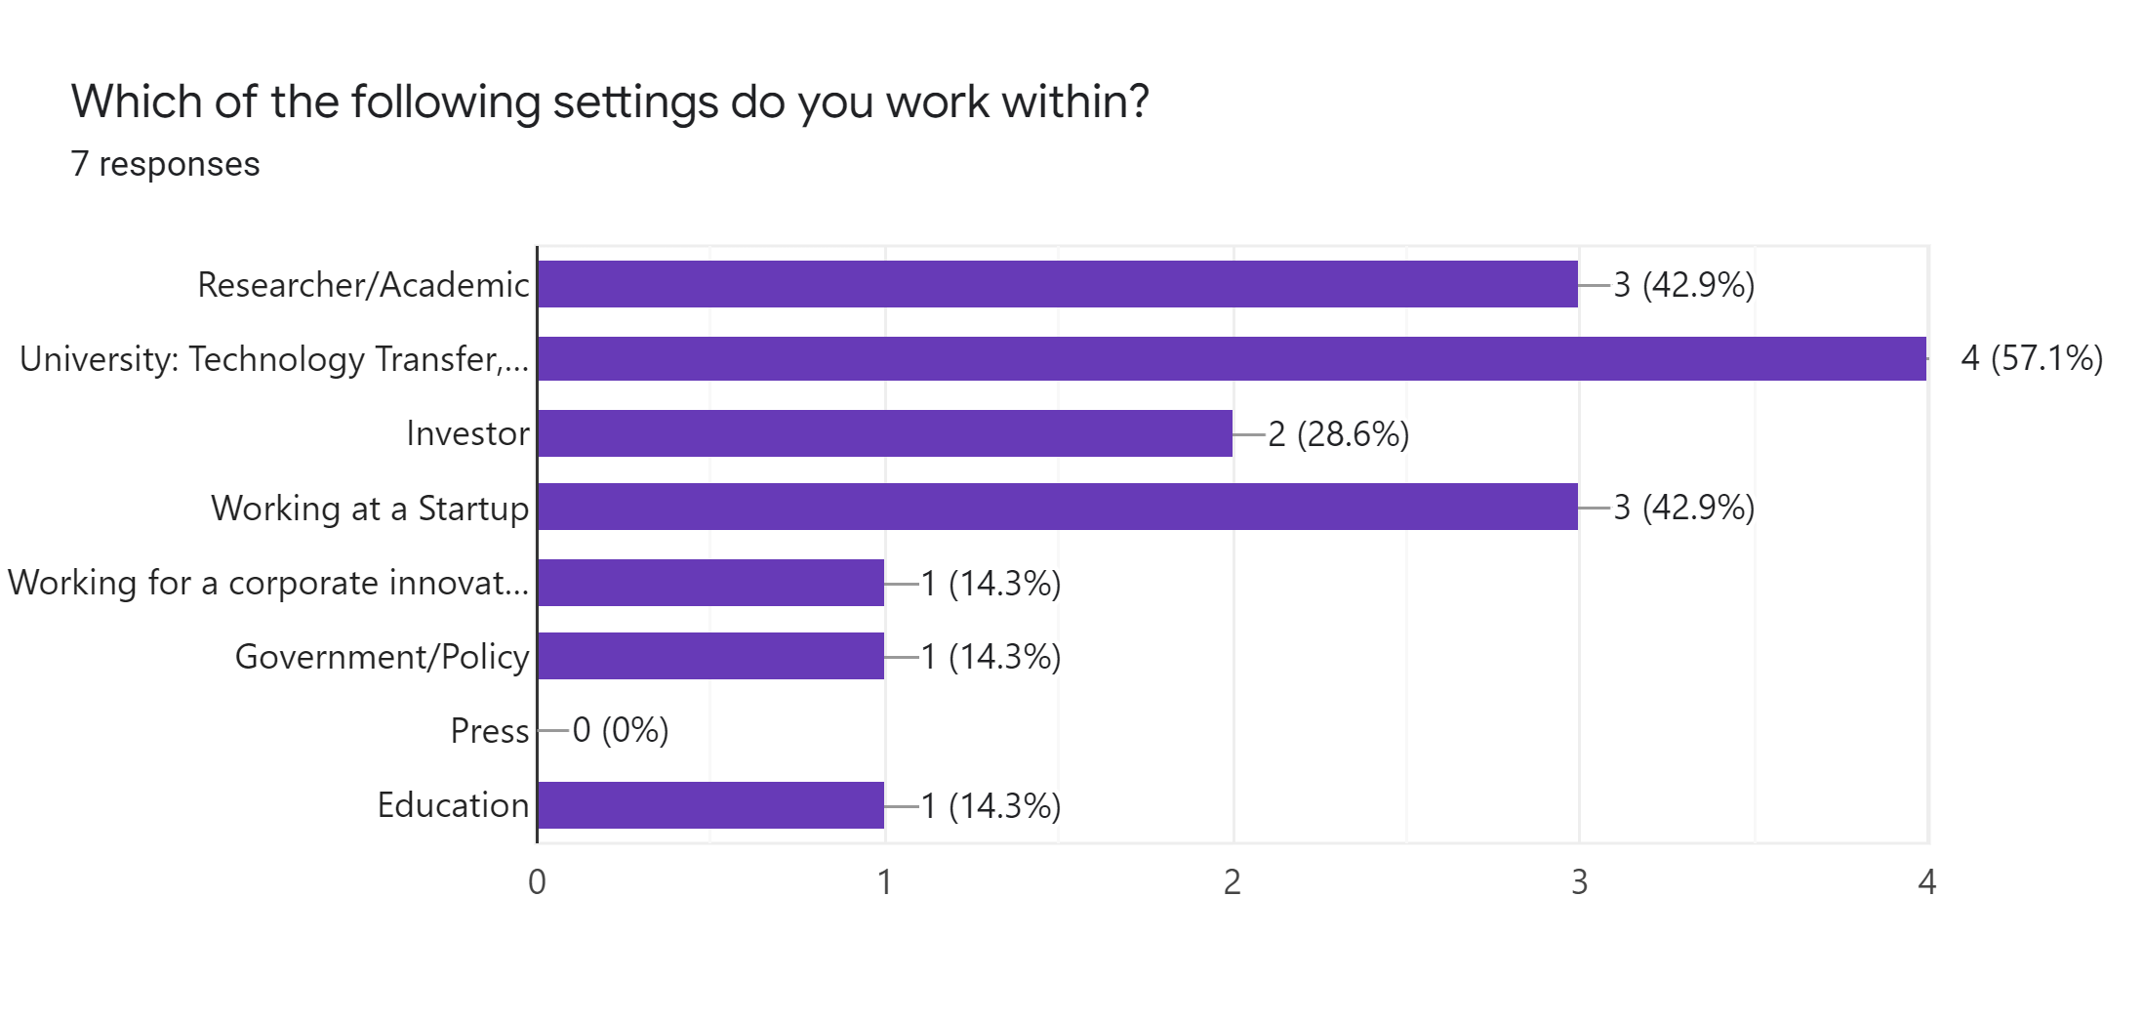



Innovation Activity of Cities in the U.S
Shruti Misra¹, Neha Kardam¹, Boyuan Xie¹ and Mai Peng²
UW CSE512: Data Visualization – Spring ‘22
¹Department of Electrical & Computer Engineering, ²Department of Mechanical Engineering
Motivation
Design Goals
To develop a novel visualization application that can enable relevant stakeholders visualize and explore innovation activities in the U.S and analyze the role of university-industry collaborations in bolstering innovation.
The objective is to design a cohesive, expressive dashboard that allows users to track, analyze, and leverage the data that interests them.
This project is based on comparing metrics of innovation in the three categories above across different cities in the U.S for 2019.
How did the expenditures of higher education R&D vary across different metro cities in 2019?
How did industry structure differ in different metro cities in 2019?
How dis venture capital differ in different metro cities in 2019?
Preliminary Data Analysis
Table: Data Sources
In 2019, out of 384 metropolitan area in the U.S, 37 of them received funding
75% of Federal Research Funding
67.1% of SBIR/STTR funding
95.0% Venture Capital Funding
Data Collection
Federal R&D Funding Data: Grants.gov and National Science Foundation Databases
Industry Structure Data: Bureau of Labor Statistics Database and Pitchbook
Venture Capital Data: Pitchbook
Approach
Evaluation/Feedback
We created an anonymous survey with a snippet of our visualization to find out:
Who are our users?
Whether they find proposed dashboard useful?
We gathered data from a variety of sources, including Fred economic data and labor statistics, to identify the 36 cities with the most SBIR and Federal funding and capital investment.
We also compiled data on the top five industries for 36 cities and analyzed it to see how they contribute to employment and if there is a correlation between grants and employment industry.
Final design includes a University Map (filtered by city), Static Pie Charts, Pie Charts to show top 5 industry sectors, top 5 VC investments, and a percentage breakdown by industry sector.
We discovered that:
Our 7 seven users are employed in industries such as healthcare, artificial intelligence, and advanced manufacturing.
57.1 percent of users will benefit directly or indirectly from our interactive dashboard.
More than half of the users work in university technology transfer, while 42 percent are from academics and a few are startup employees.

Slide 2
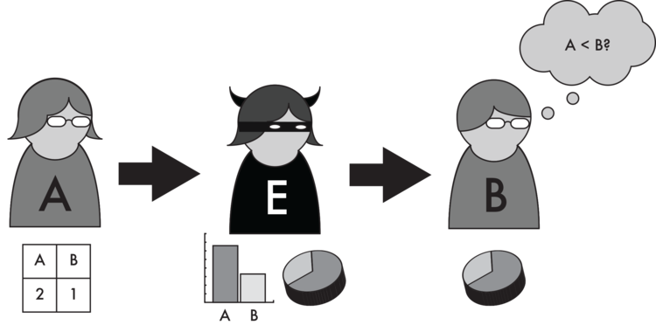
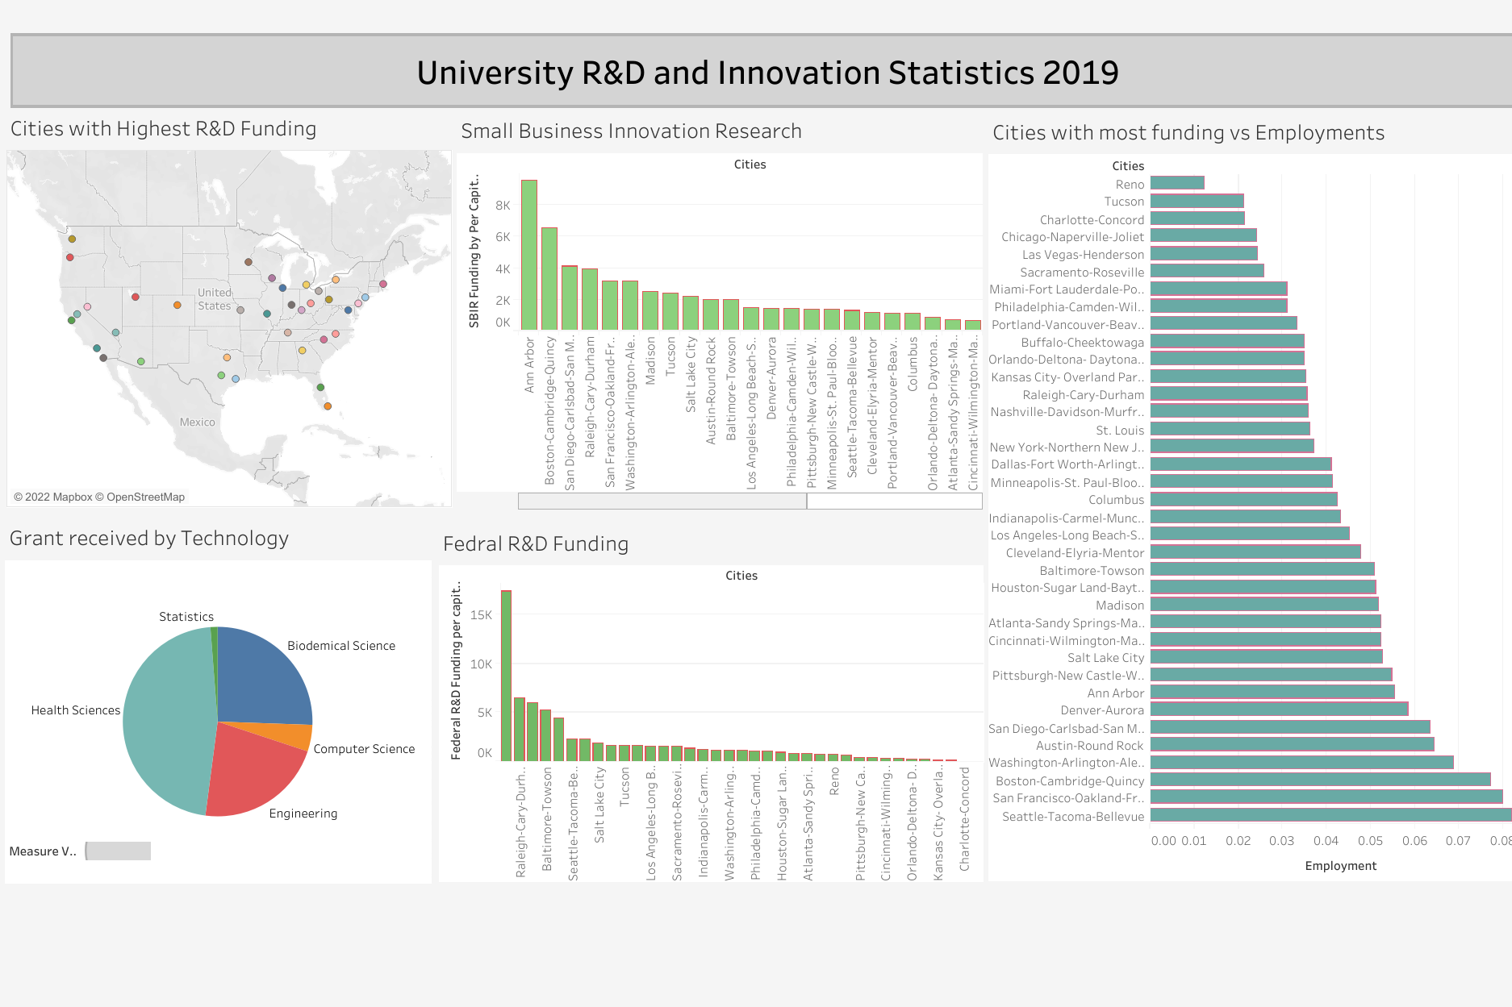
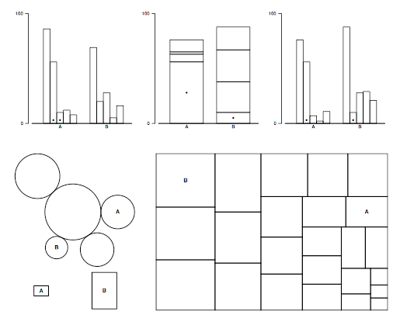
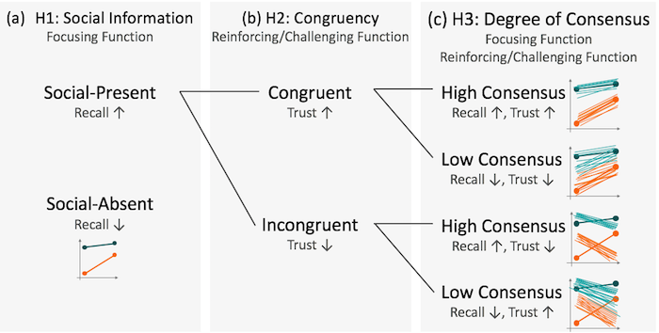

Innovation Activity of Cities in the U.S
Shruti Misra, Neha Kardam, Boyuan Xie and Mai Peng
UW CSE512: Data Visualization – Spring ‘22
Motivation
Design Goals
As part of Shruti’s dissertation, she is developing a novel visualization application that can enable relevant stakeholders visualize and explore innovation activities in the U.S and analyze the role of university-industry collaborations in bolstering innovation. In this context, innovation activities include research and development activities (R&D), venture capital activities and entrepreneurial activities.
Fill in text here
Replace figures
Blah
Blah
…
Approach
Fill in text here
Blah
Blah
…
Fill in text here
Blah
Blah
…
Fill in text here
Blah
Blah
…
Evaluation/Feedback
Fill in text here
Replace figures
Blah
Blah
…
Fill in text here
Replace figures
Blah
…

Slide 3
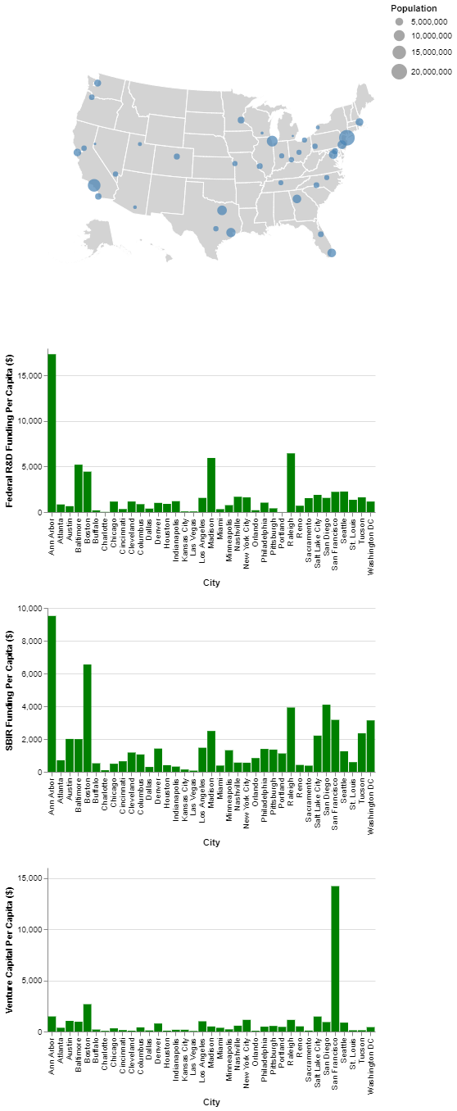
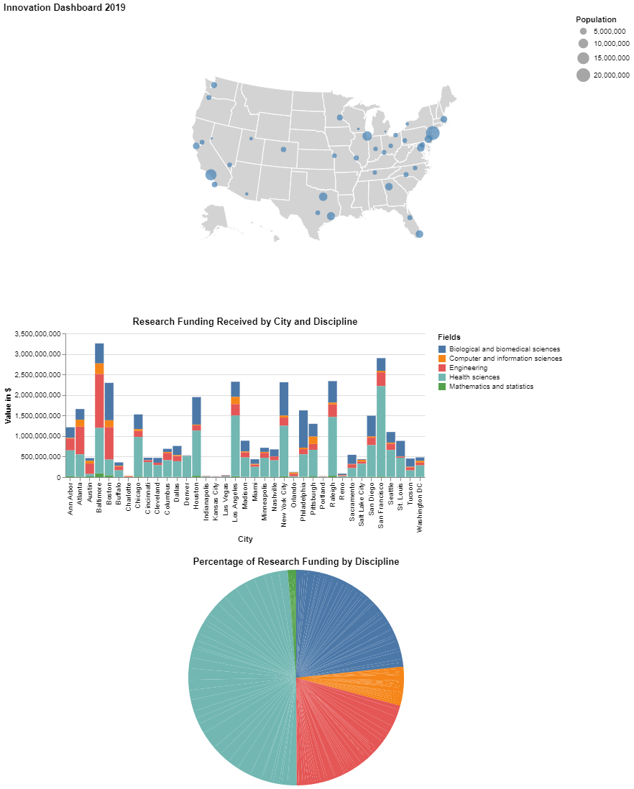
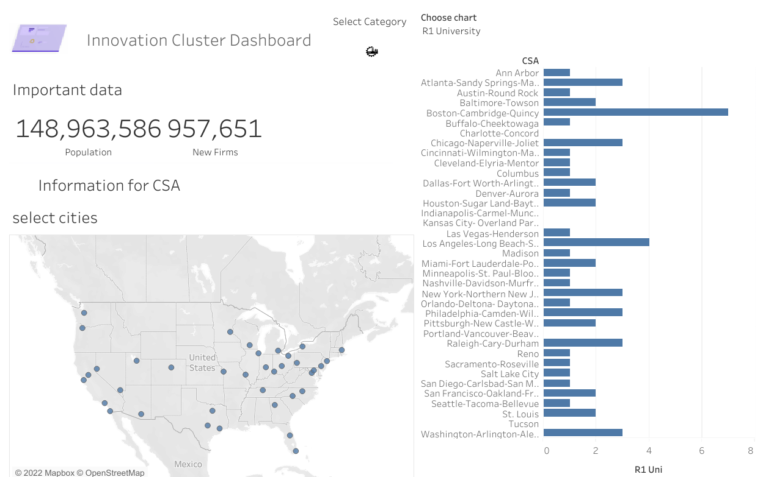




Slide 4
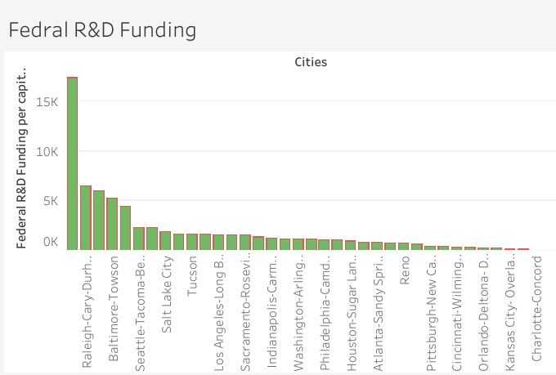
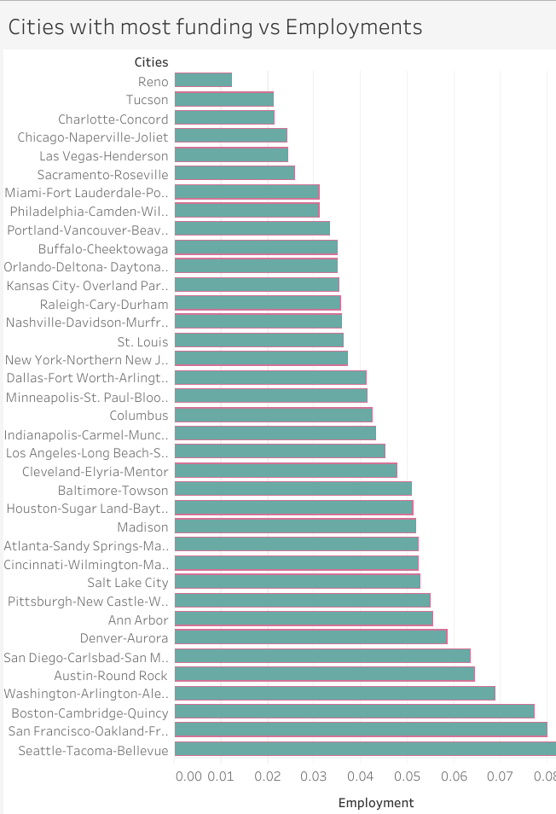
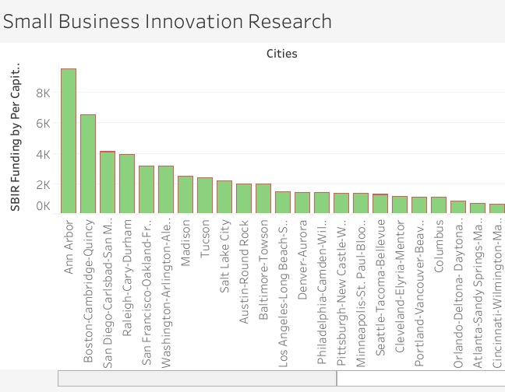
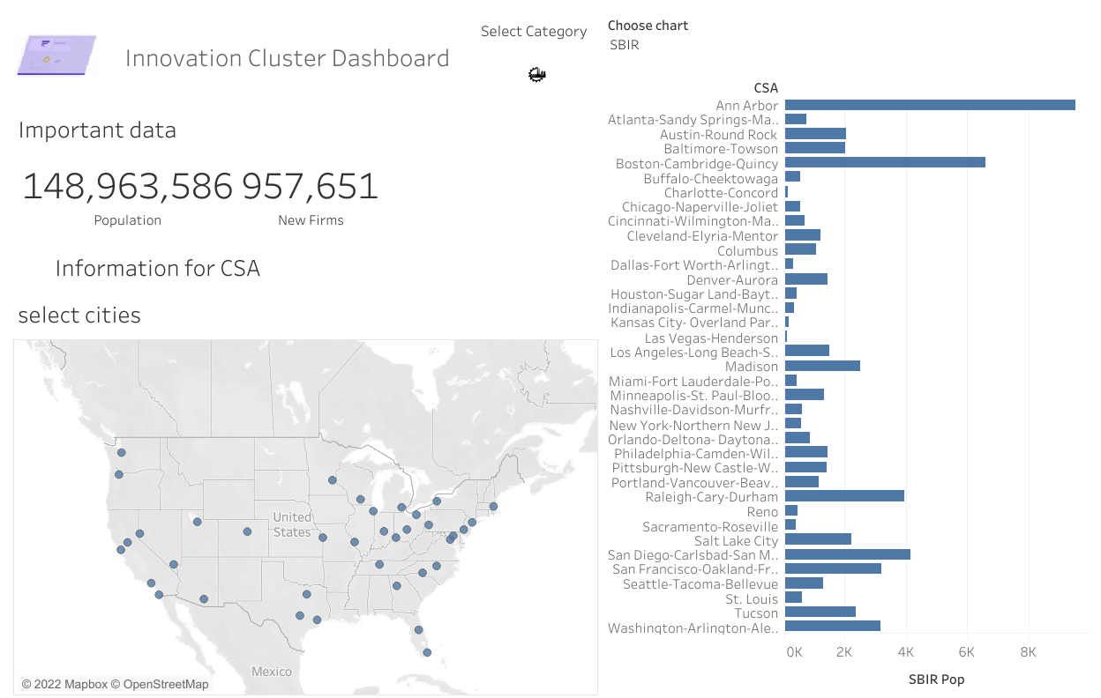
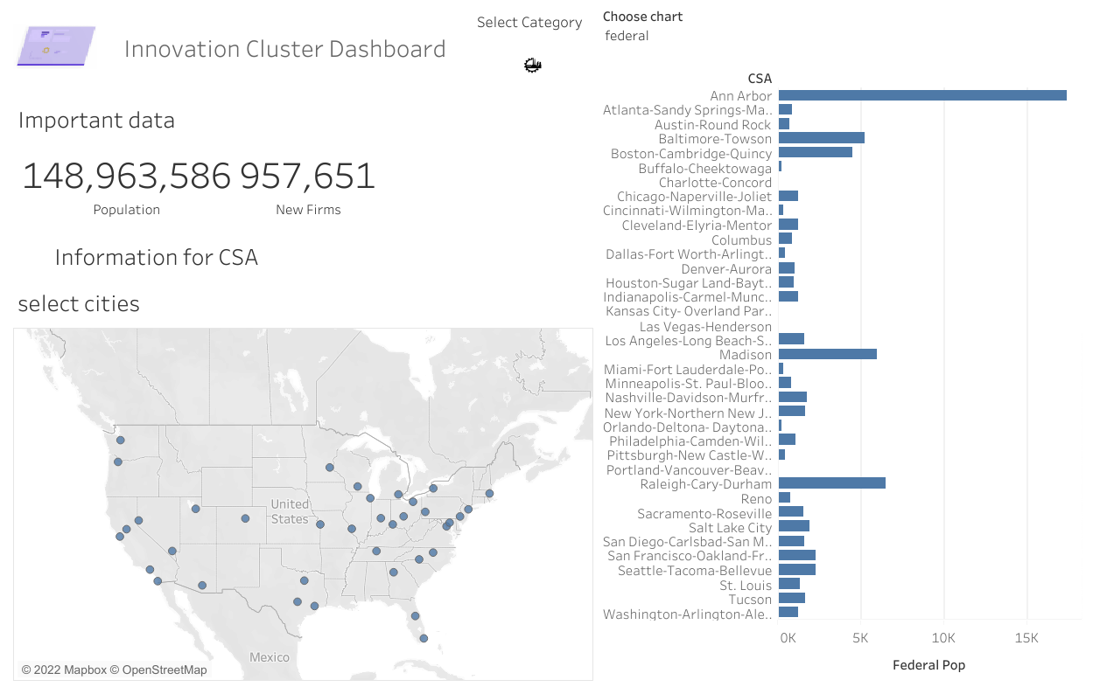
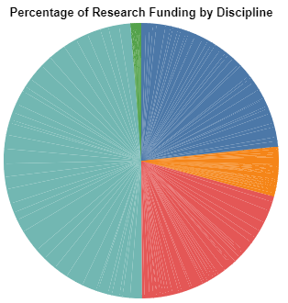
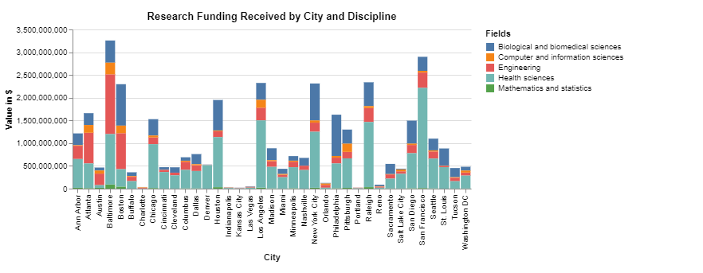
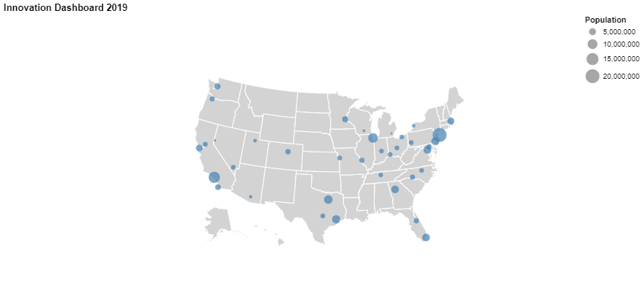
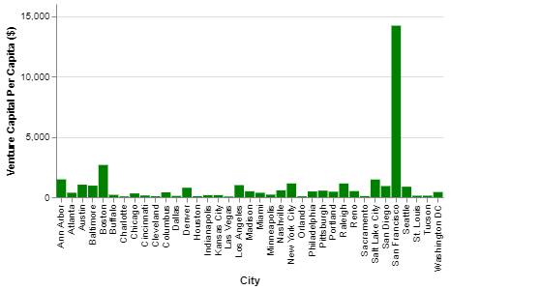
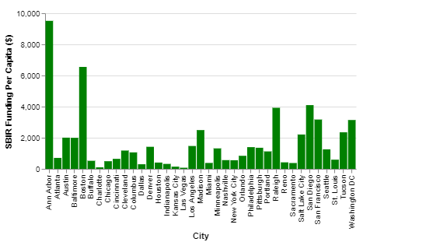
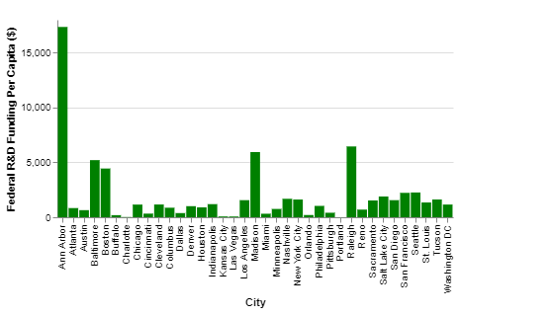
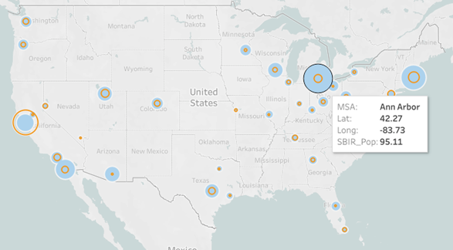
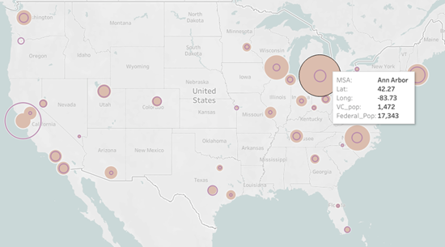

Slide 5
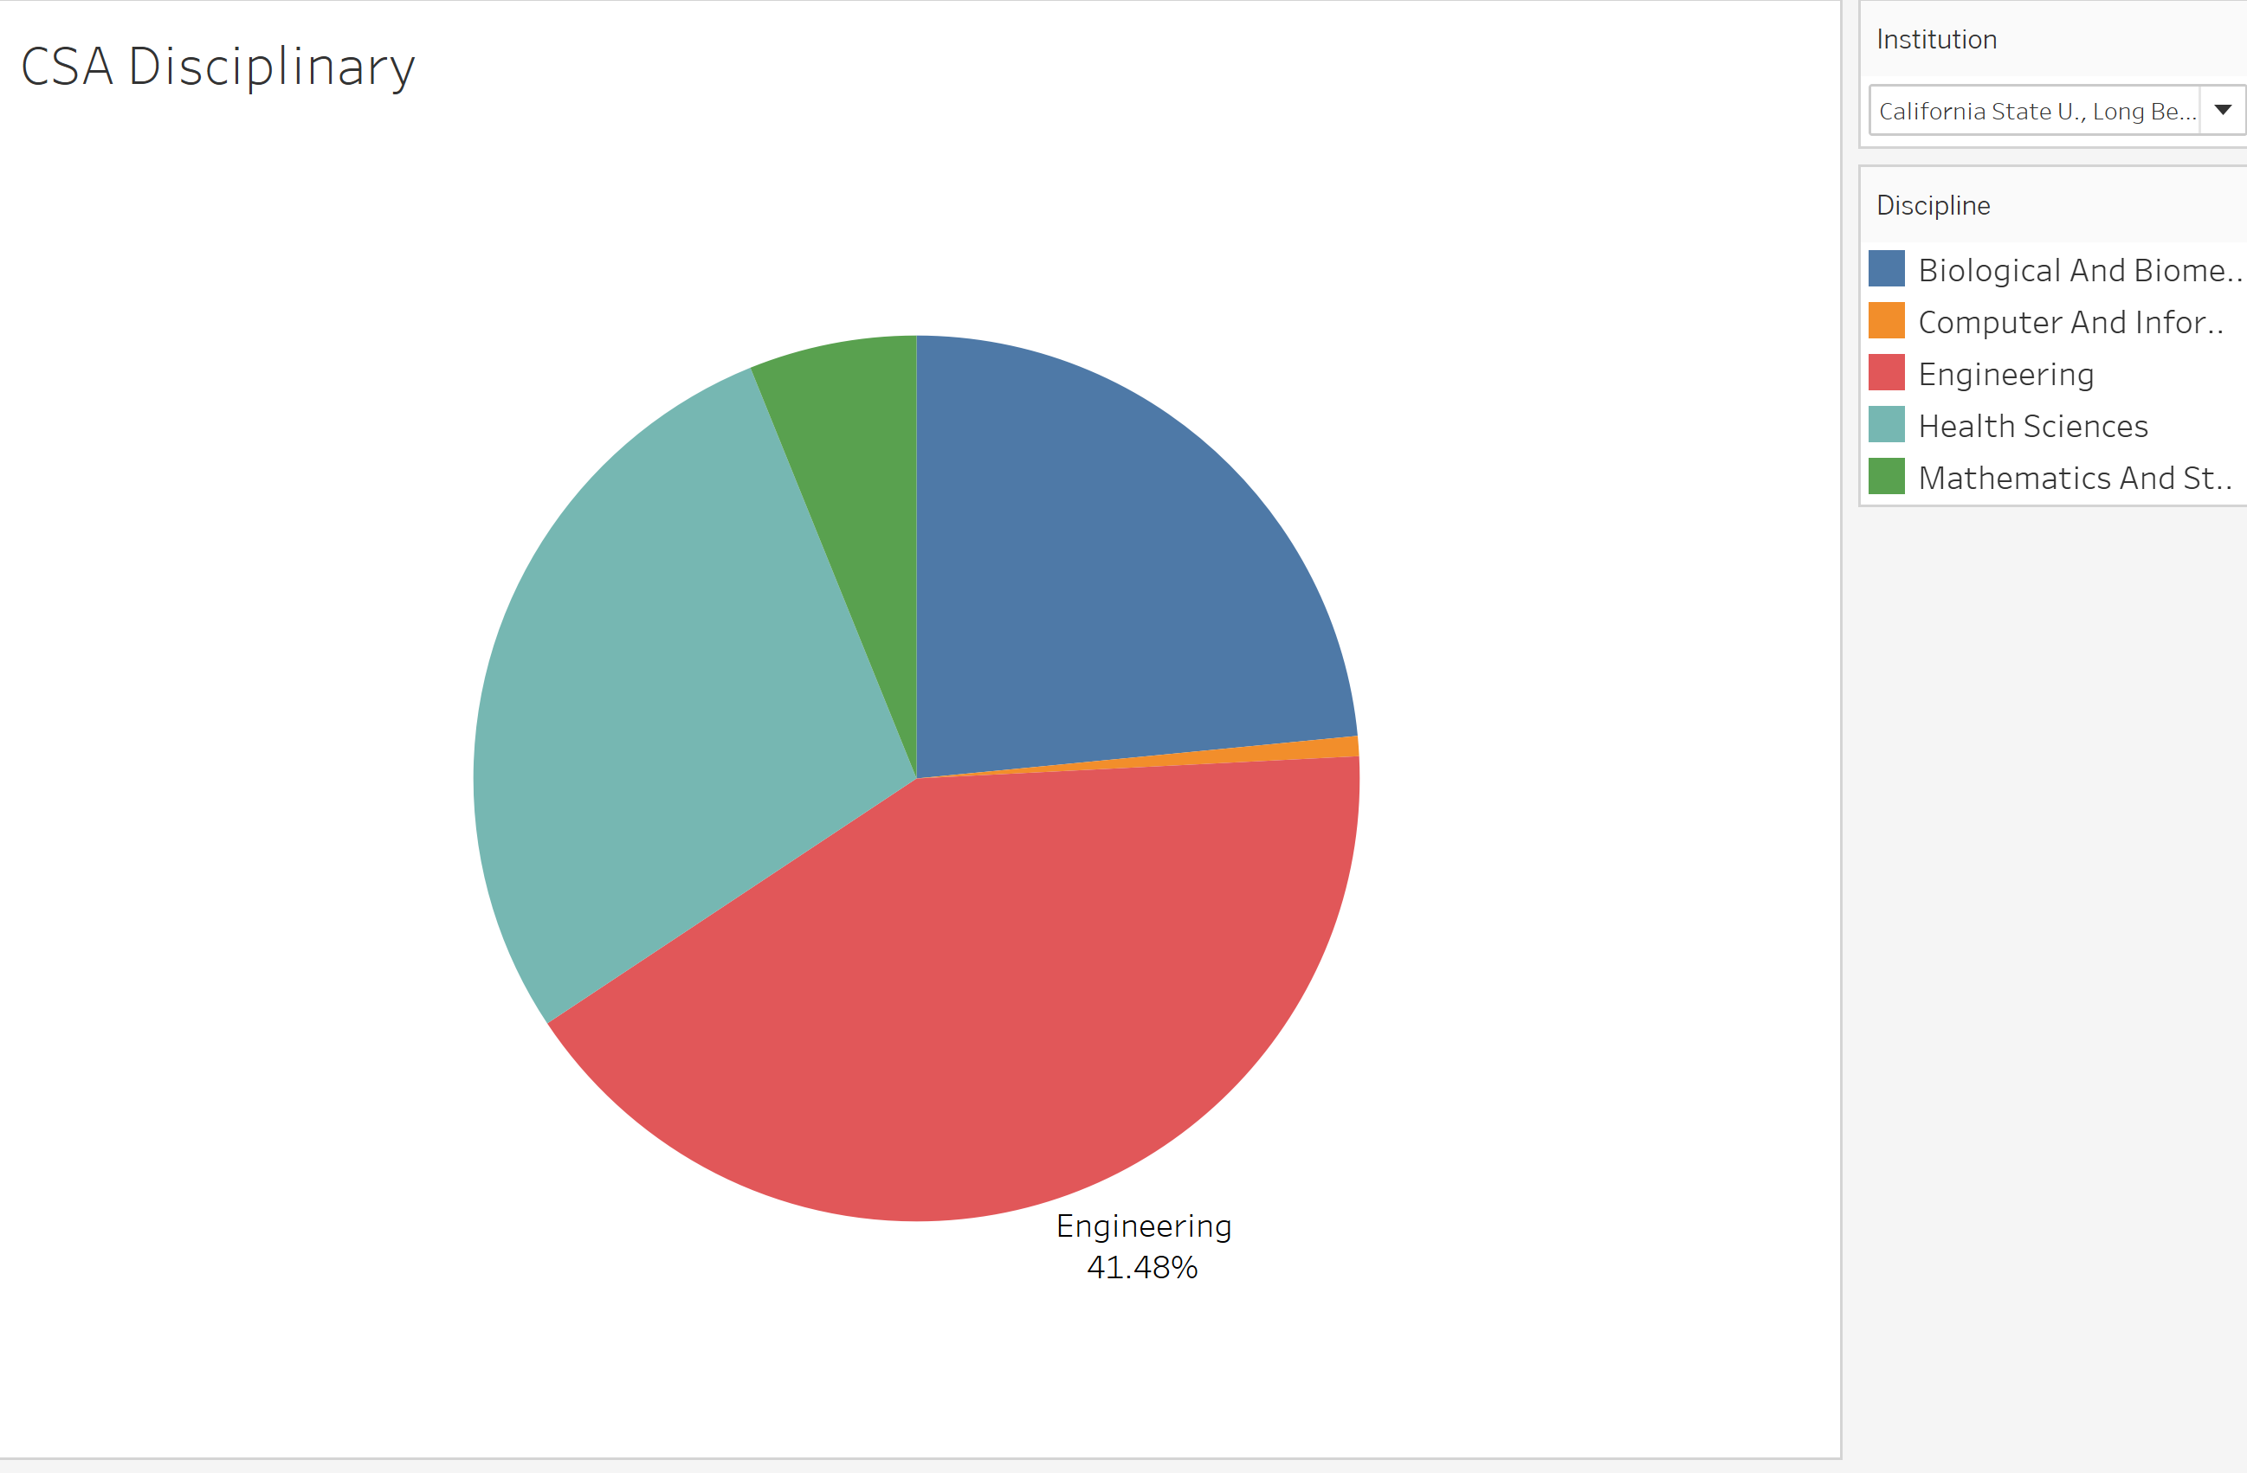
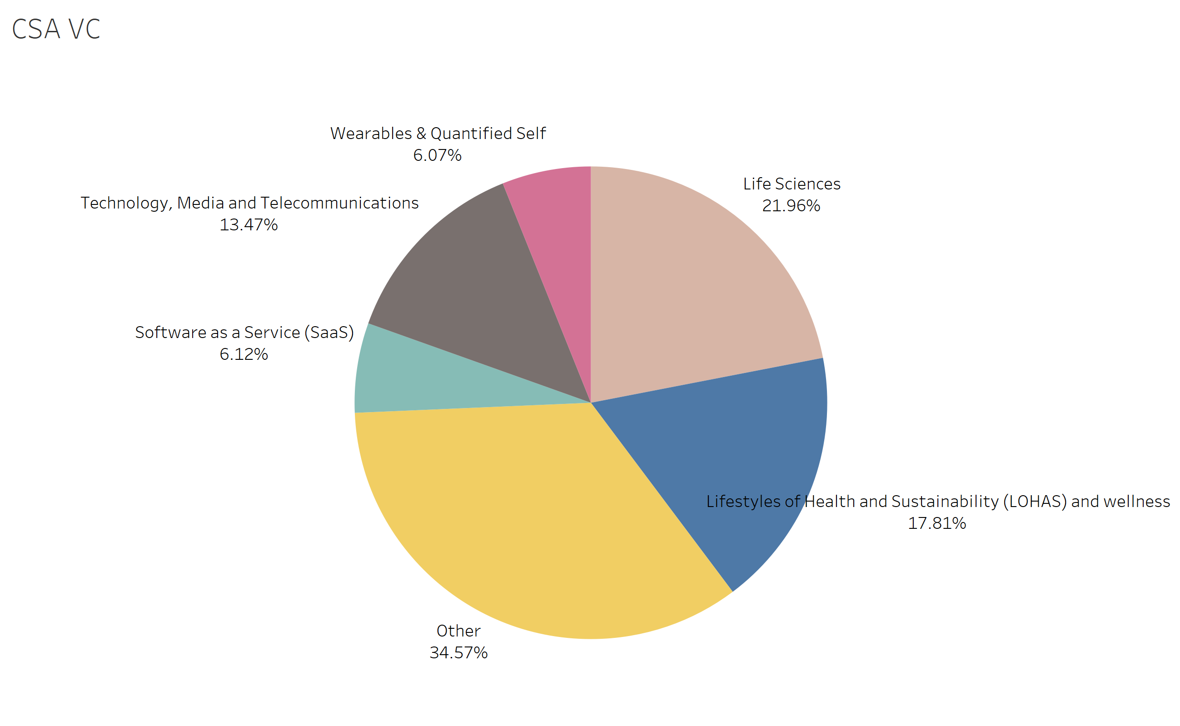
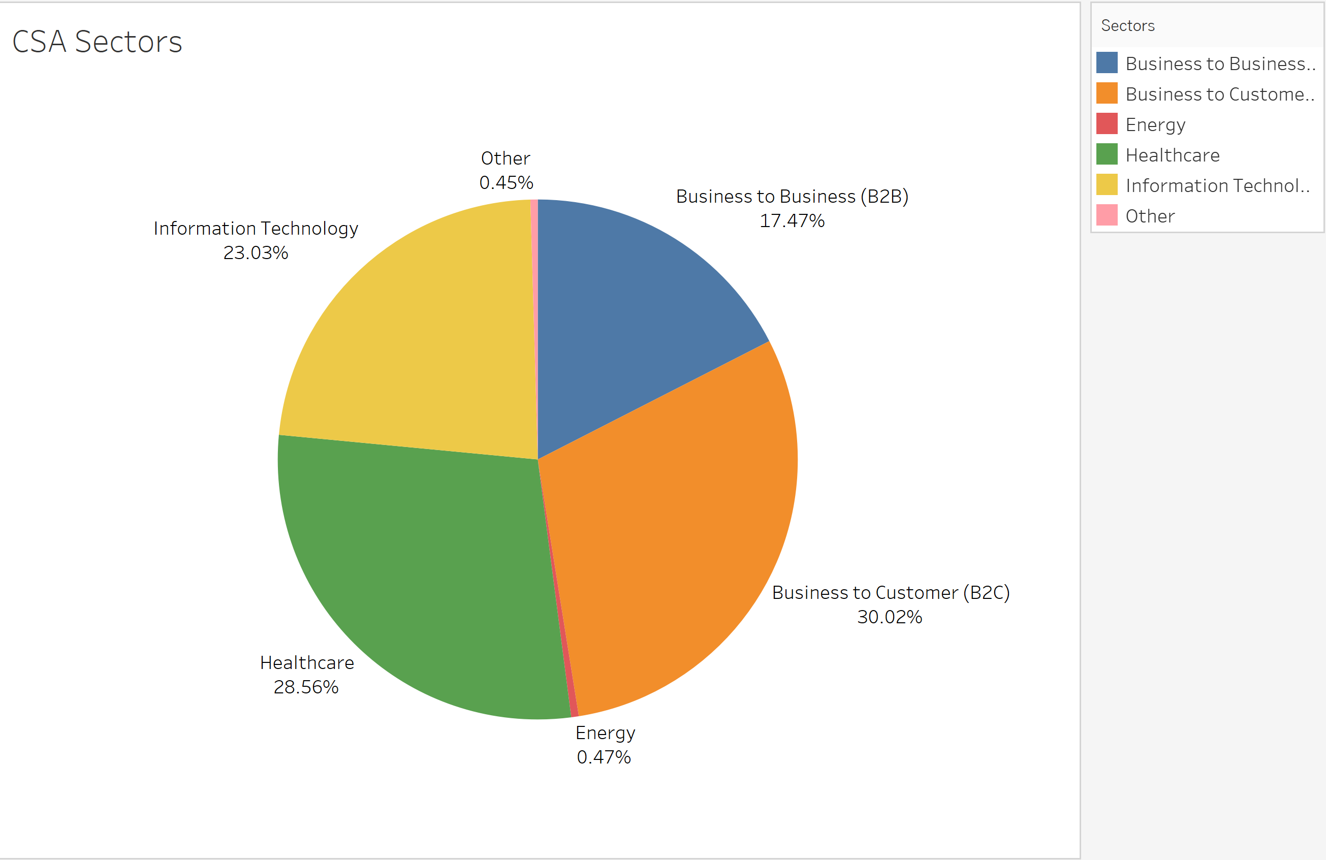
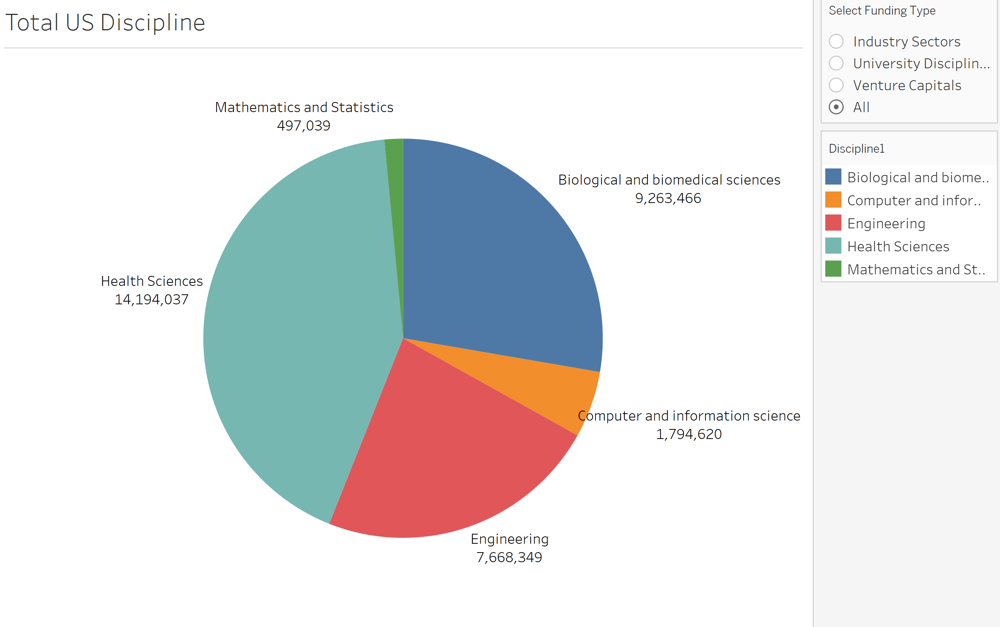
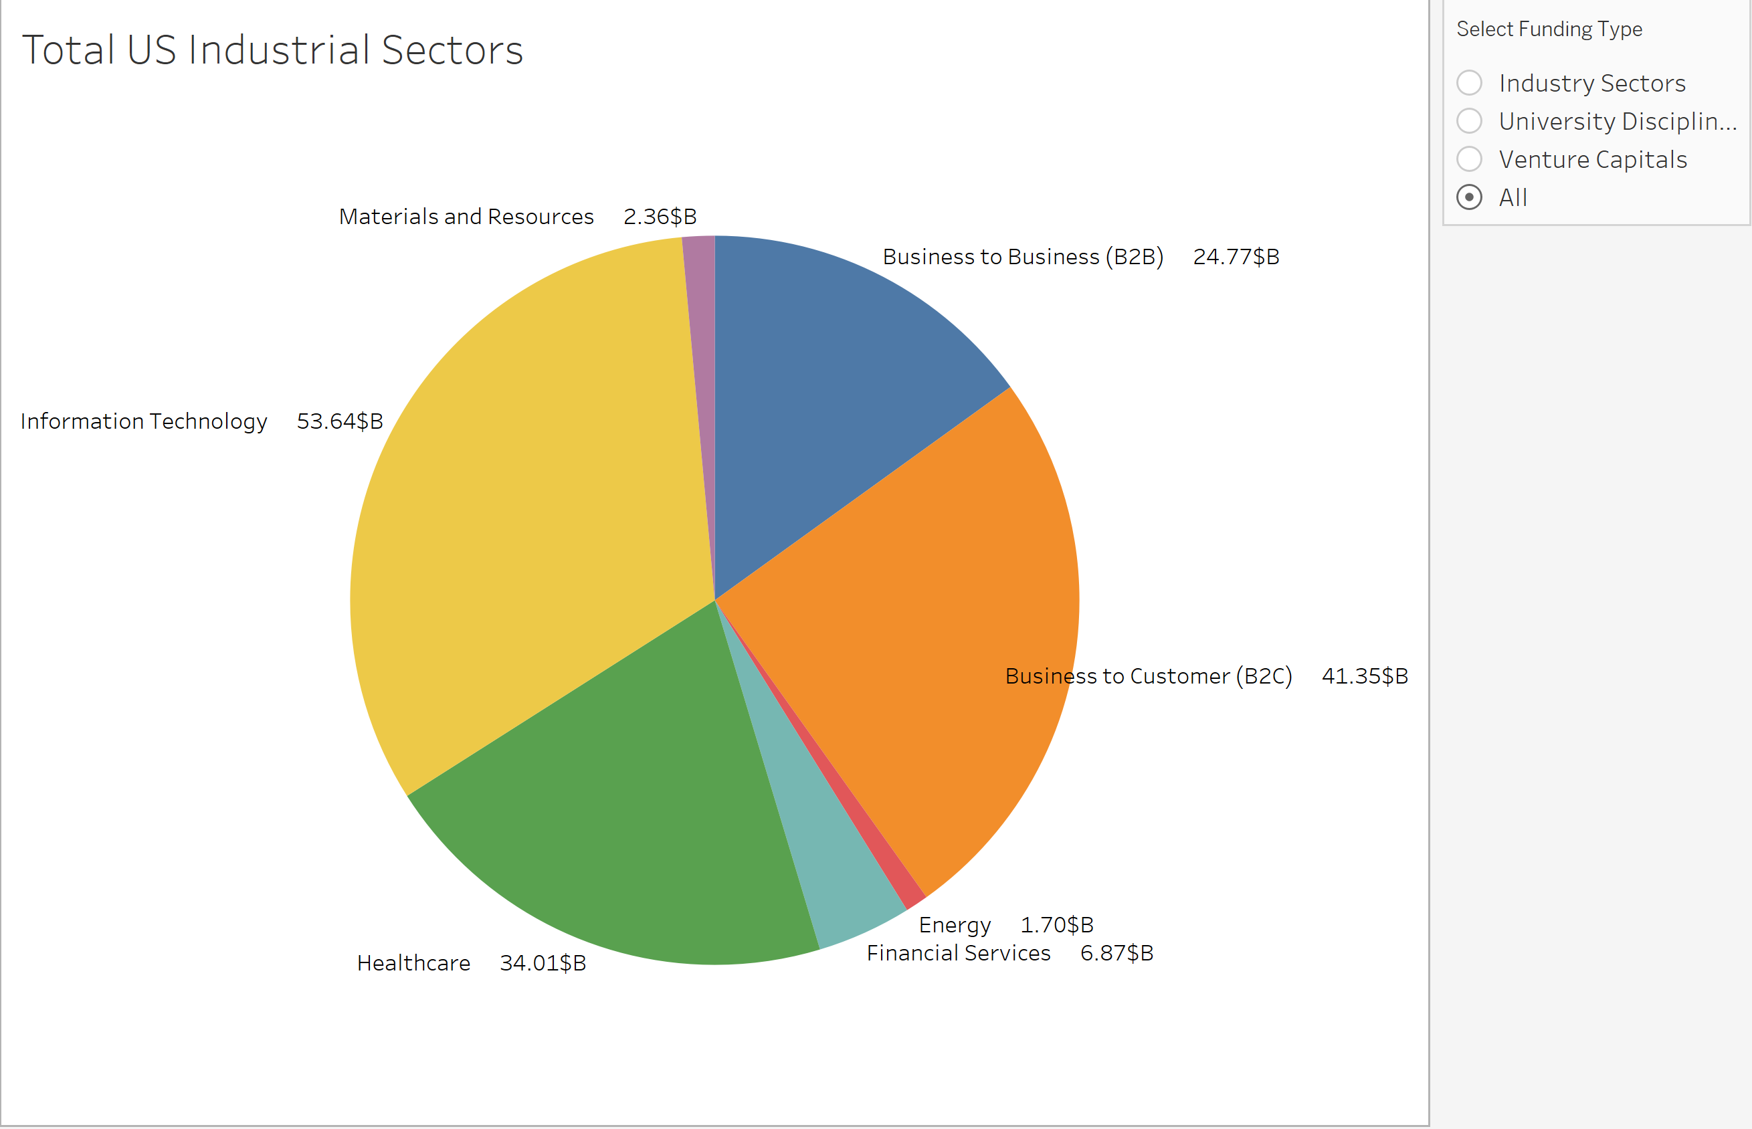
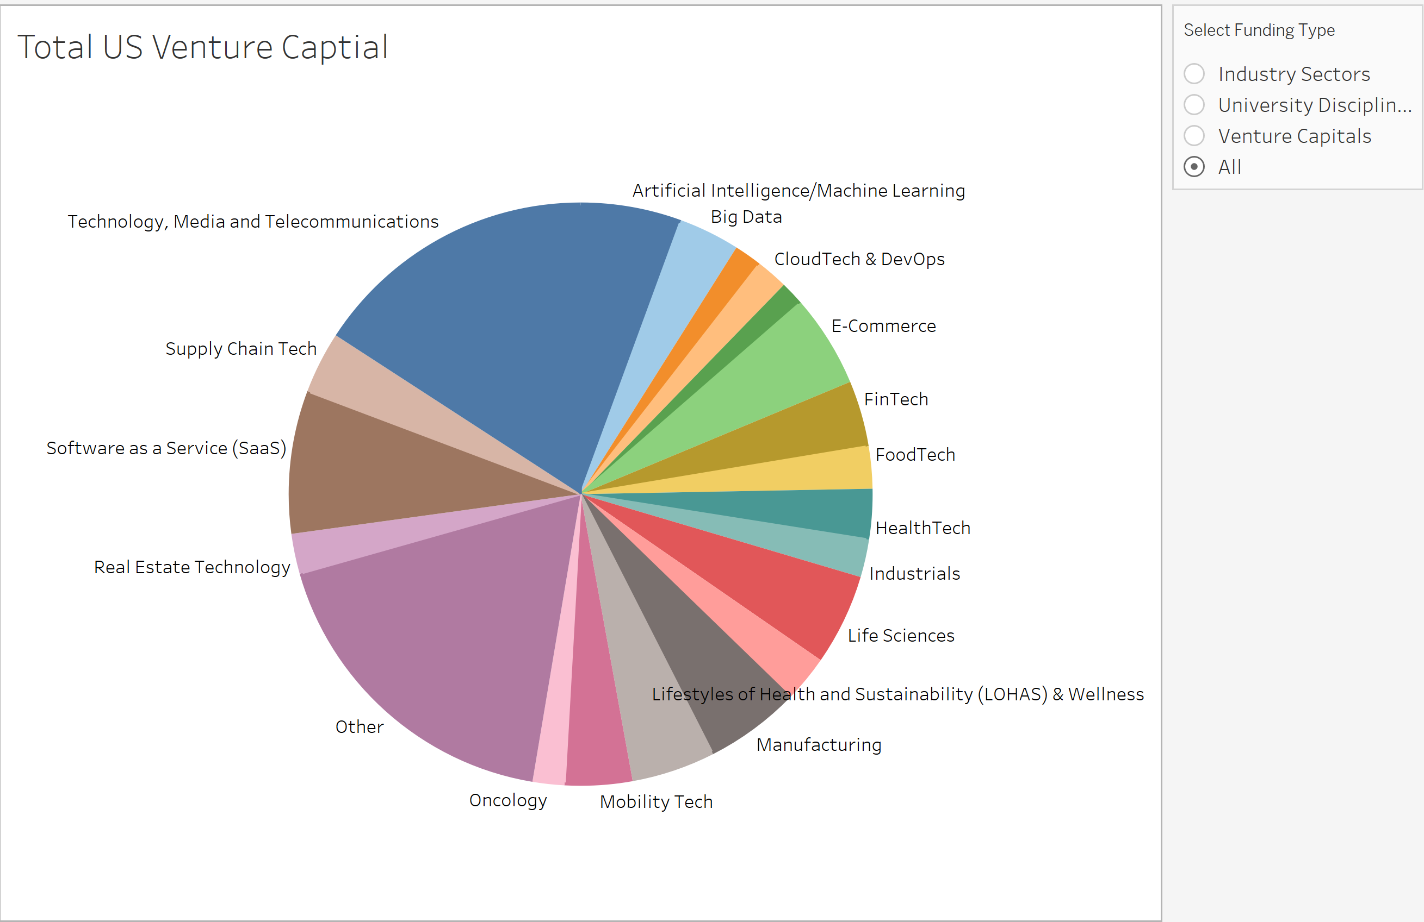

Slide 6
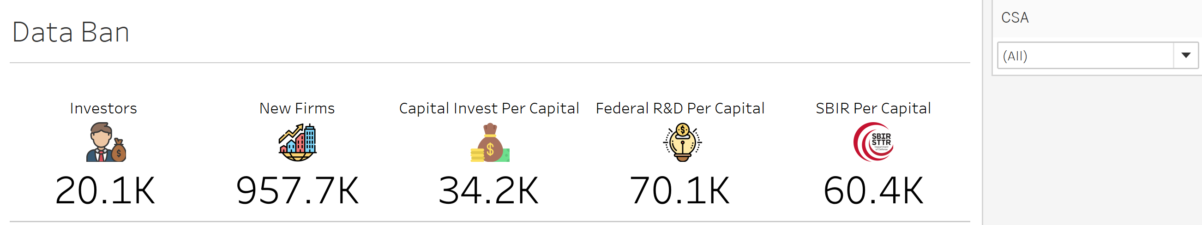
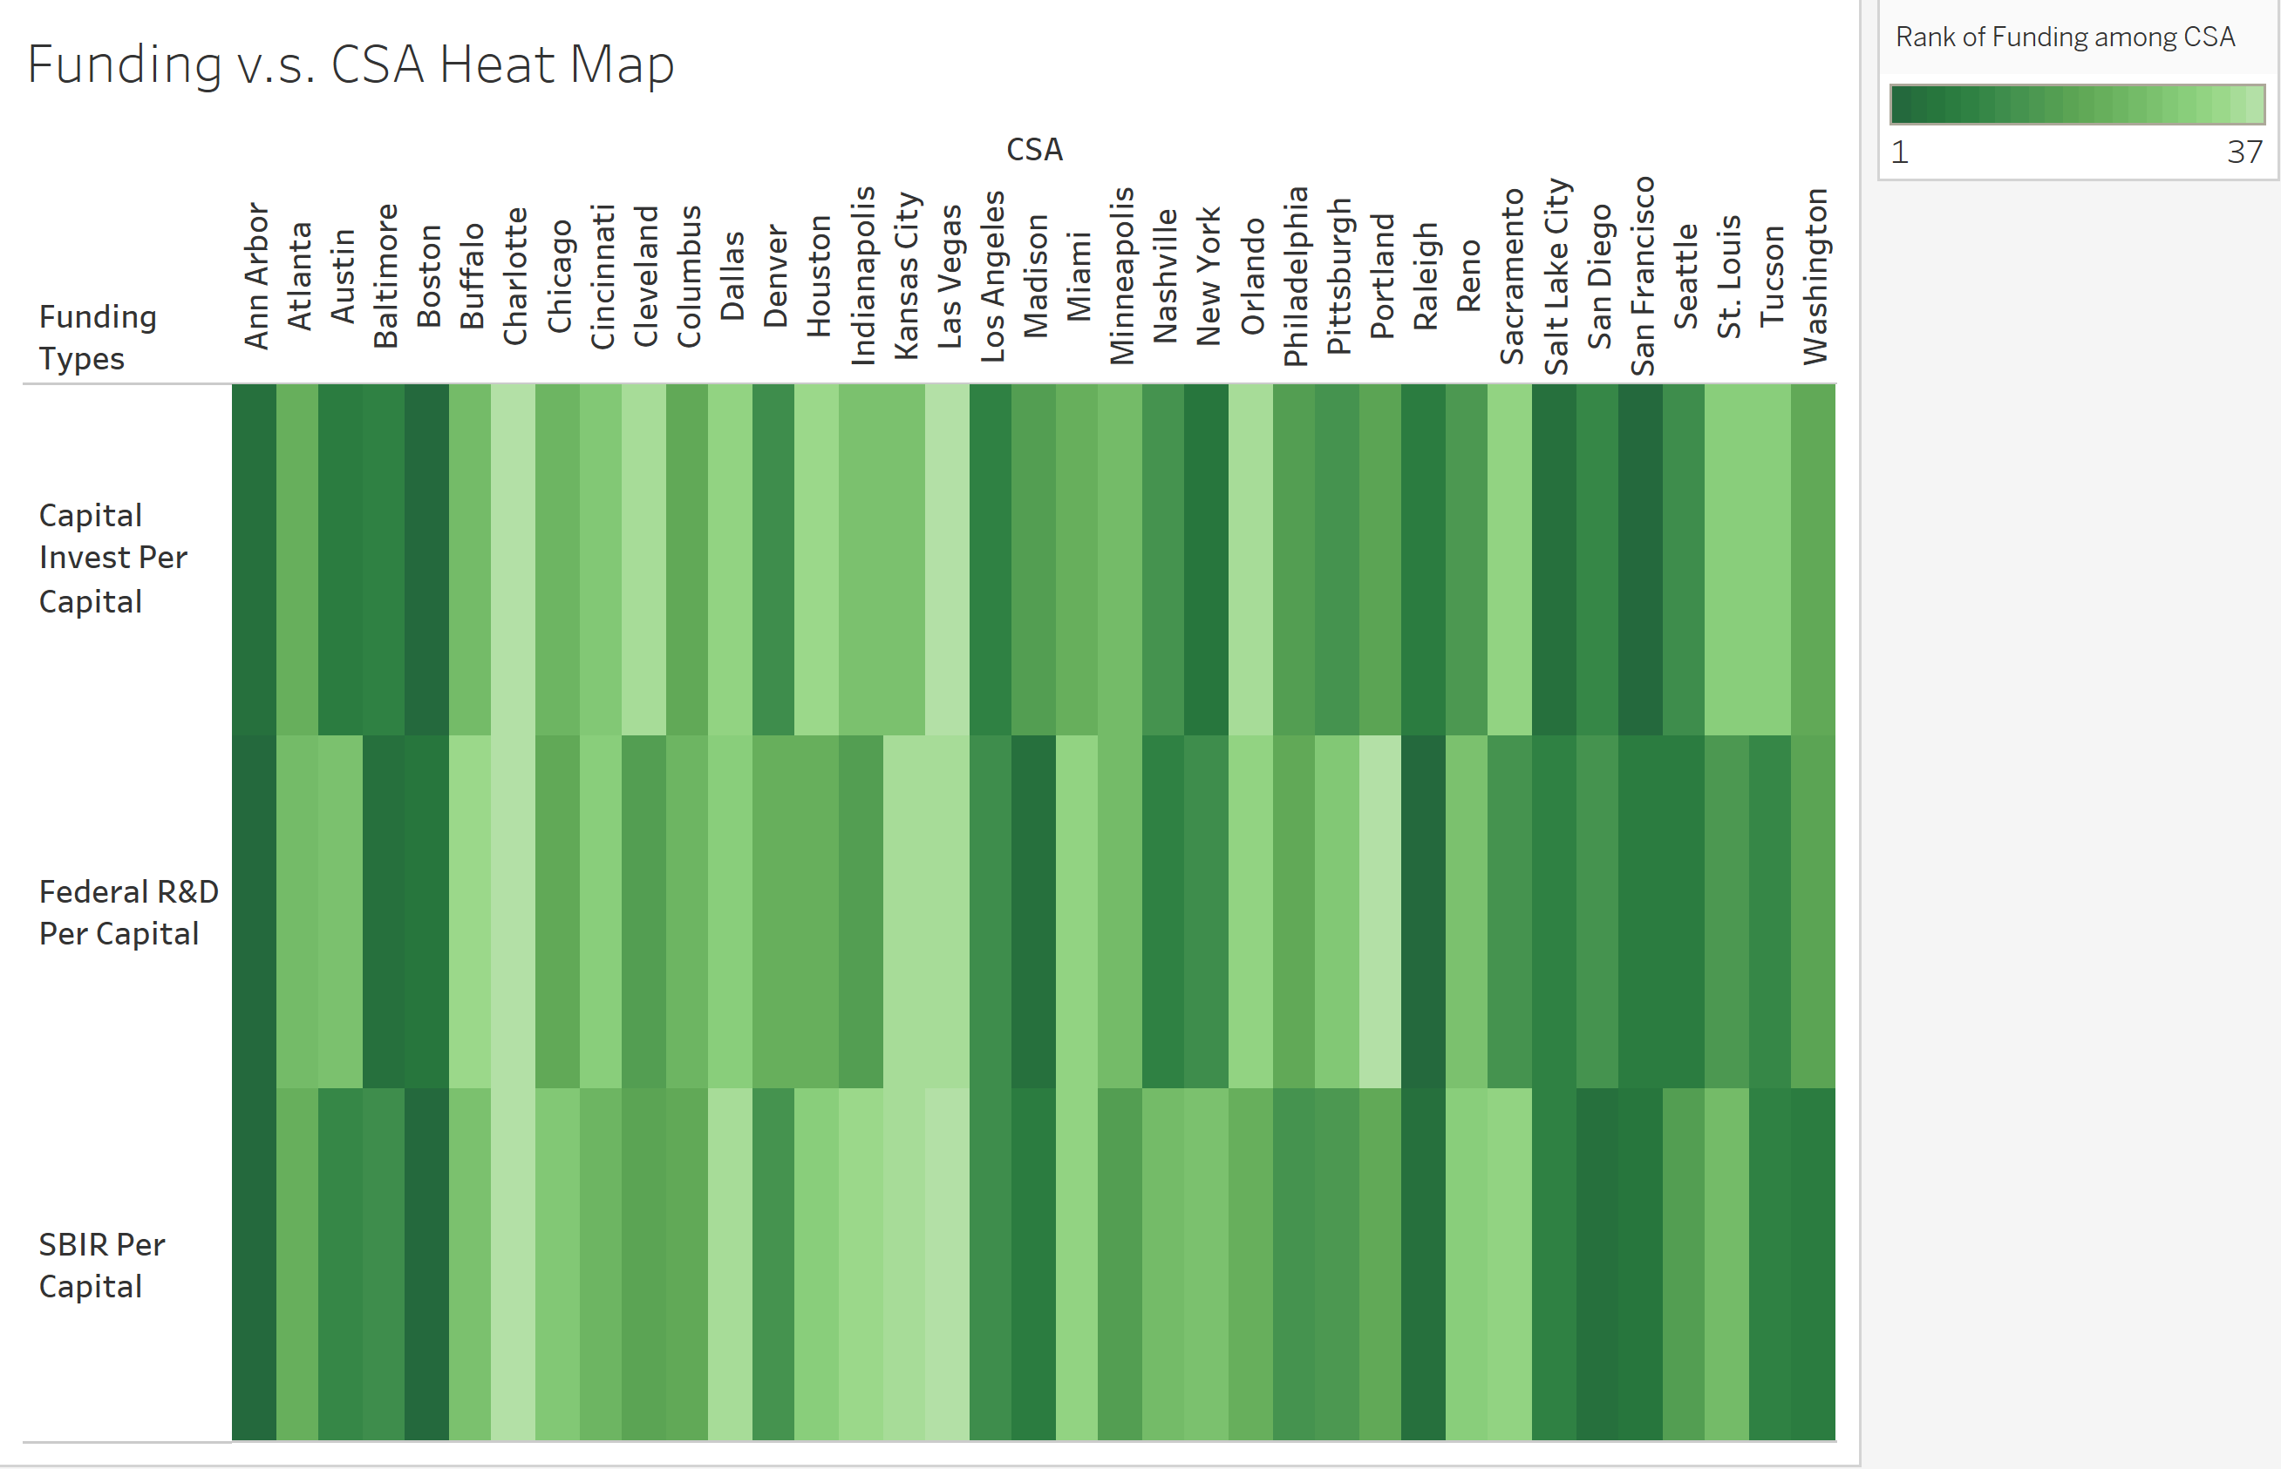
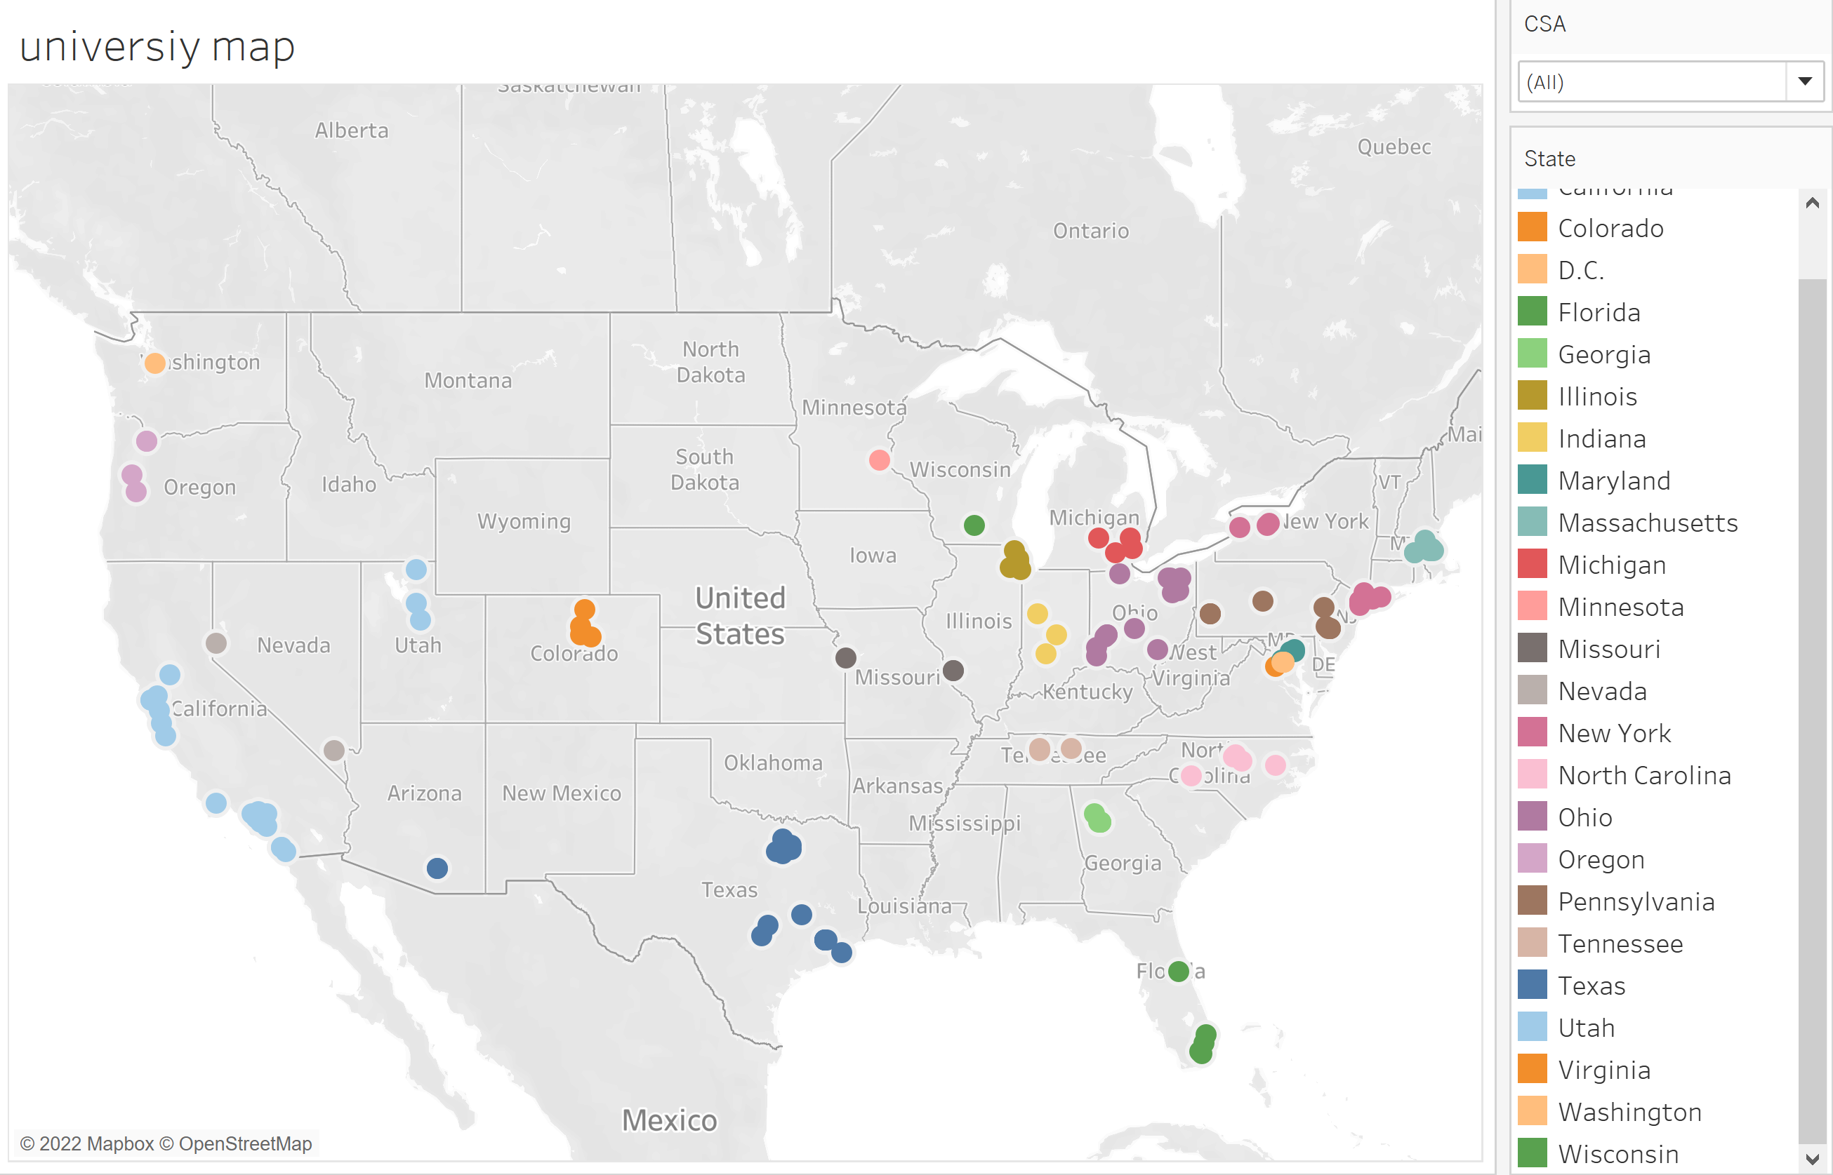

Slide 7
Motivation: To developing a novel visualization application that can enable relevant stakeholders visualize and explore innovation activities in the U.S and analyze the role of university-industry collaborations in bolstering innovation.
Design Goals: This project is based on comparing innovation metrics around university research and development (R&D), industry structure and entrepreneurship across different cities in the U.S for 2019. The questions are:
How did the expenditures of higher education R&D vary across different metro cities in 2019?
How did industry structure differ in different metro cities in 2019?
How dis venture capital differ in different metro cities in 2019?
Evaluation & Feedback: To improve our prototype of the final project visualization, we created an anonymous survey to collect feedback and inquiries about the dashboard and accompanying charts that we had designed. We received a few responses, and the participants work in industries such as healthcare, artificial intelligence, and advanced manufacturing, indicating that the responses are from those whom we anticipate the project will assist and benefit in the future. We hope that the project will serve as a useful resource for academics, investors, and policymakers.
We created an anonymous survey with a snippet of our visualization to find out:
1) Who are our users?
2) Whether they find proposed dashboard useful?
We found that:
1)Our 7 seven users are employed in industries such as healthcare, artificial intelligence, and advanced manufacturing.
2)57.1 percent of users will benefit directly or indirectly from our interactive dashboard.
3)More than half of the users work in university technology transfer, while 42 percent are academics and a few are startup employees.

Slide 8
Approach:
We first gathered data for our final project from a variety of sources, including, but not limited to, Fred economic data and labor statistics, in order to identify the 36 cities with the highest levels of SBIR and Federal funding and capital investment. In addition, we compiled data on the top five industries in these cities and analyzed collected data to determine how different industries contribute to employment in these cities and if there is a correlation between the number of grants awarded and the employment industry.

